Slide 1






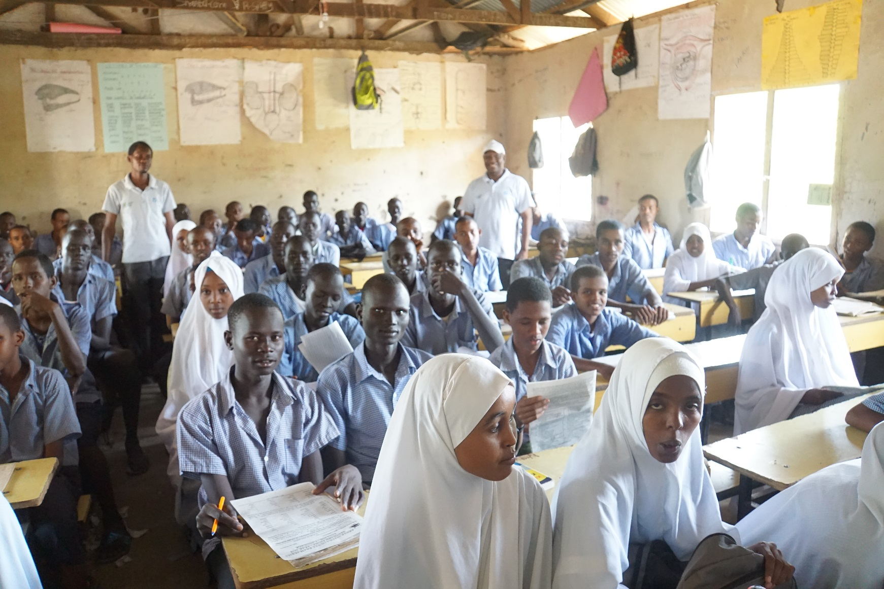
Innovation and Collaboration to Meet Crisis Situations:
Teacher Training in Kakuma Refugee Camp

Slide 2

Co-Creation and Co-Development

Slide 3

Better Results Through Joining Forces

Slide 4

Sustainability and Scalability

Slide 5
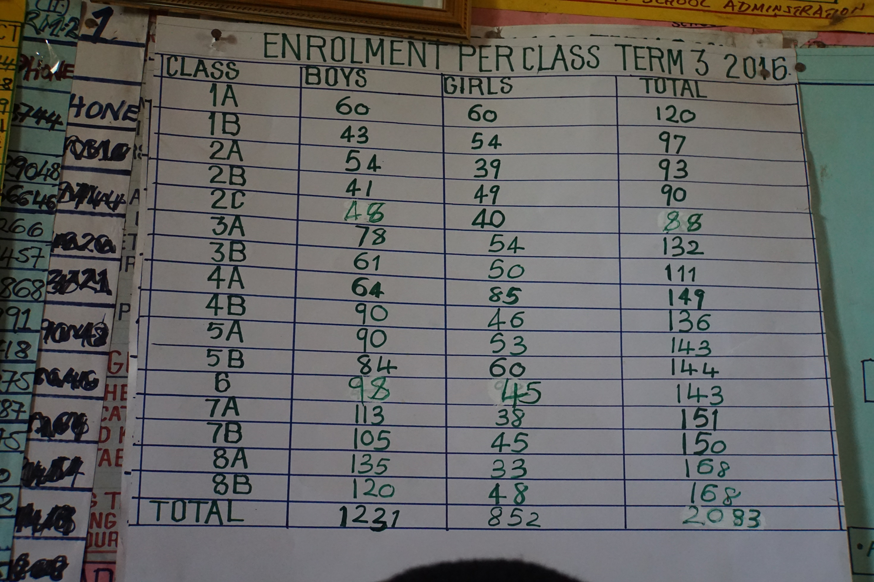

Slide 6
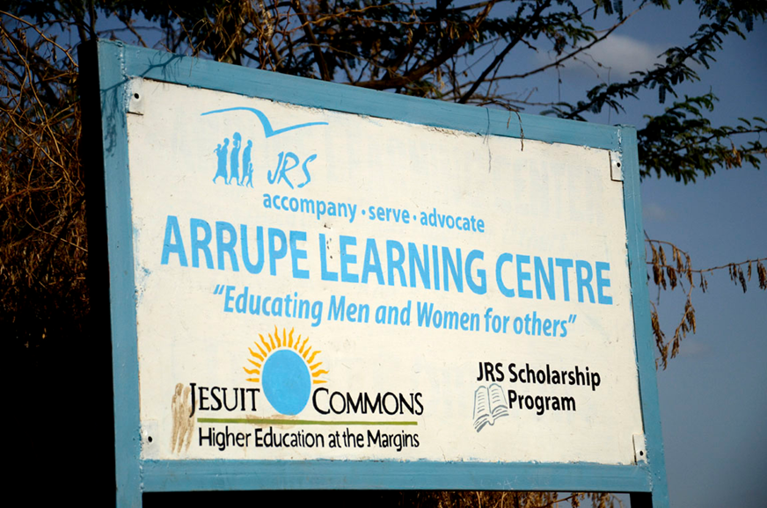
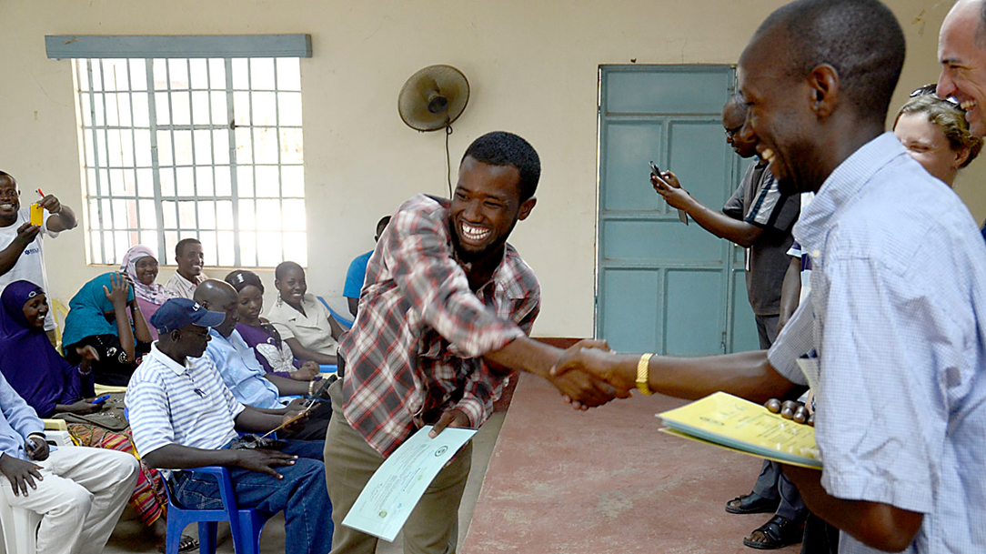
Jesuit Worldwide Learning in Kakuma
(Jesuit Commons Higher Education at the Margins)

Slide 7
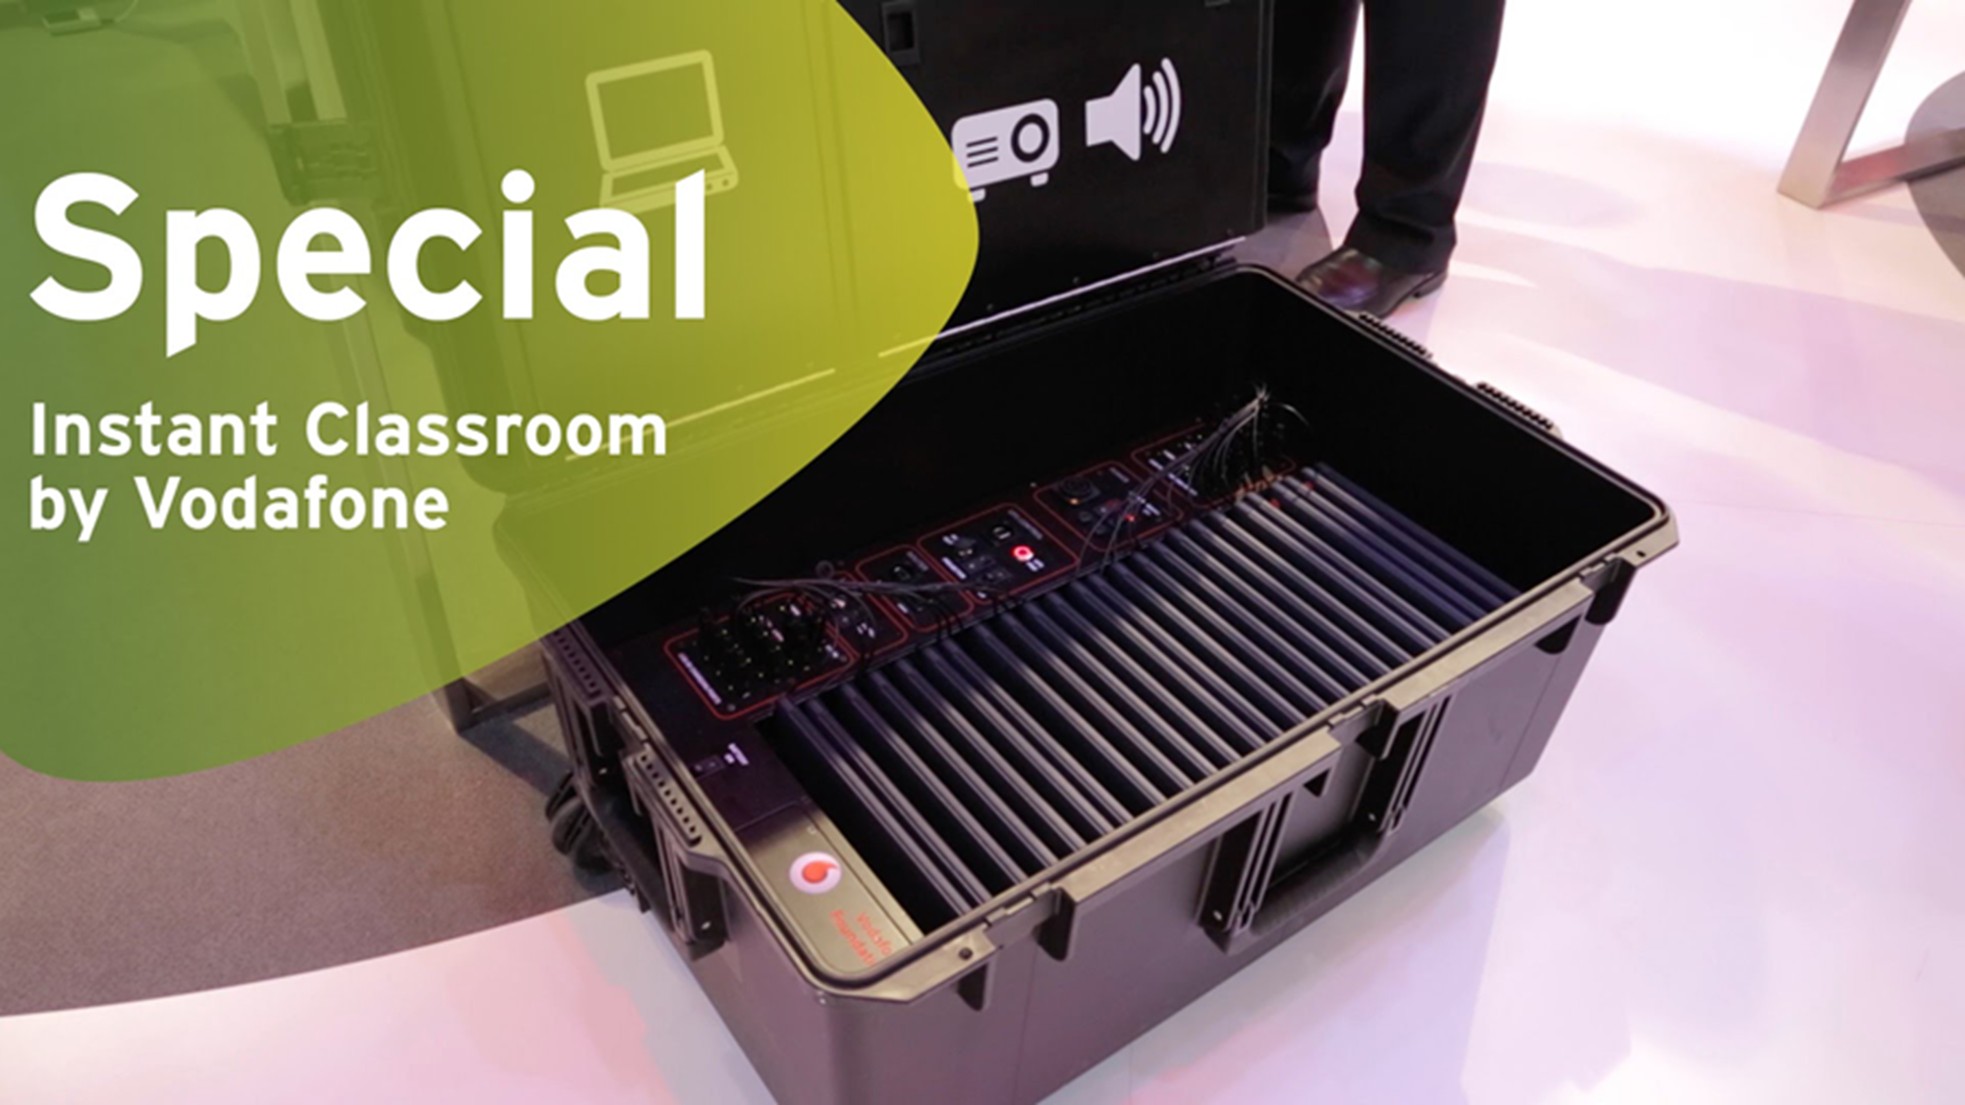

Slide 8
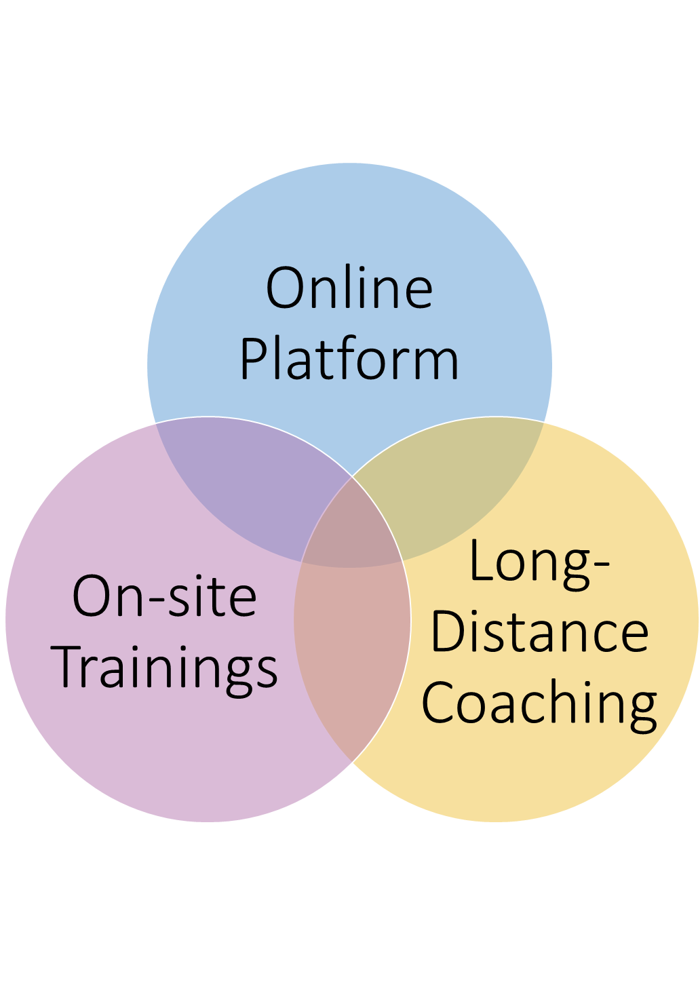
The Blended Format
on-site trainings
online dissemination of knowledge on a bespoke learning platform, and
the use of social media for individual and group coaching

Slide 9
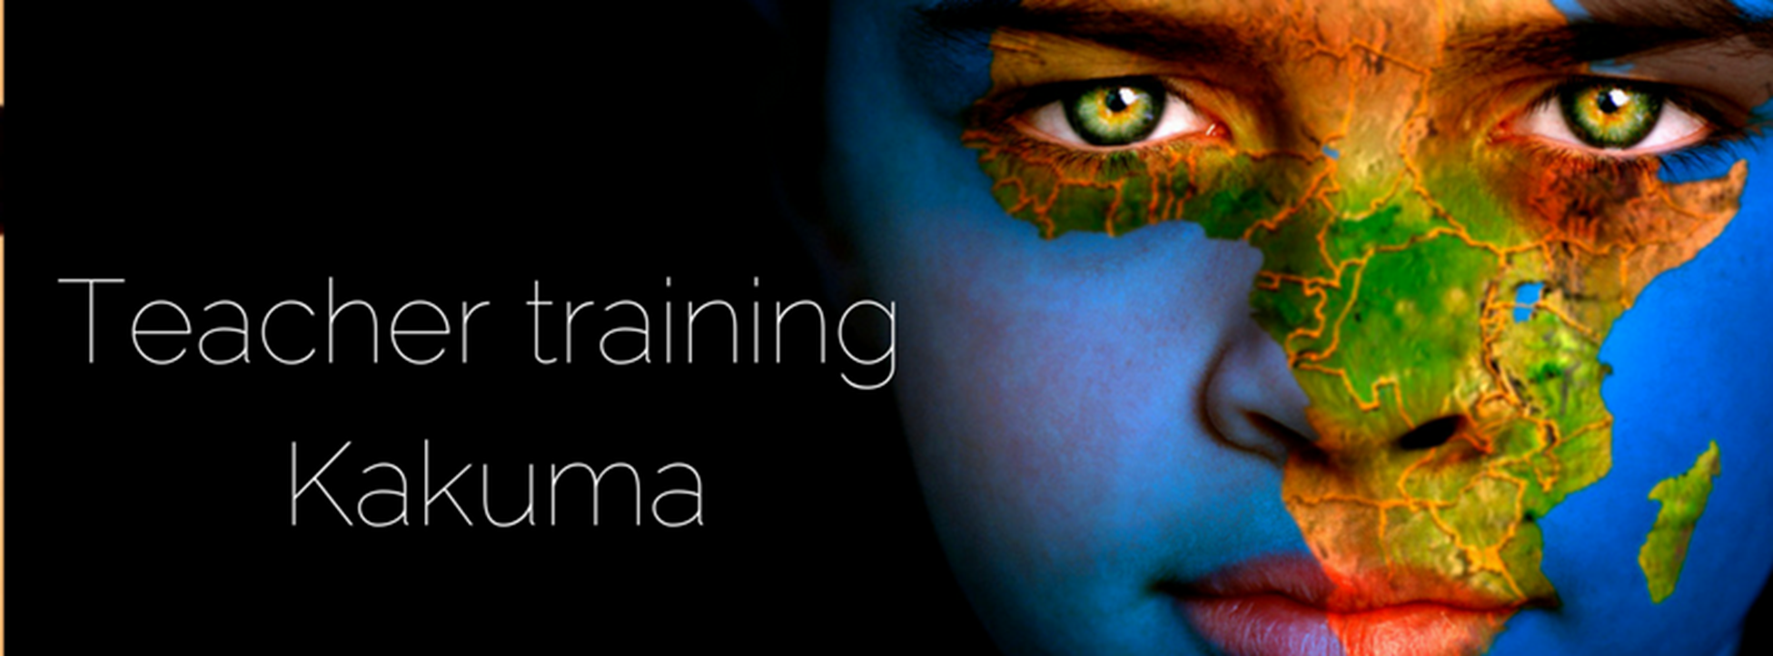
Learning Platform: teachingafrica.eurekos.com

Slide 10
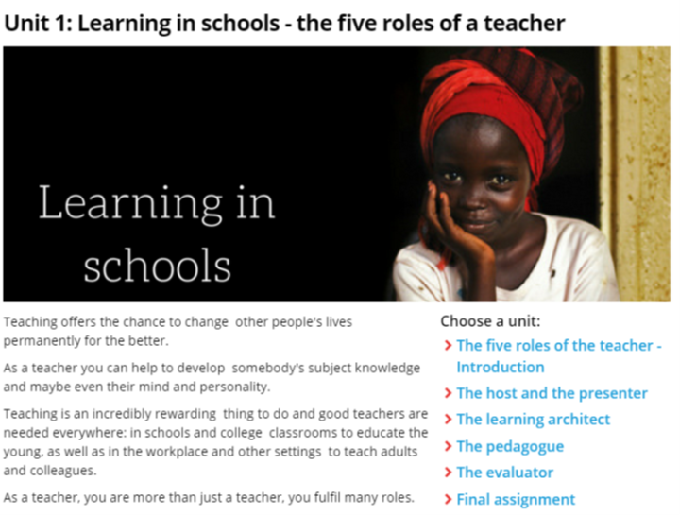

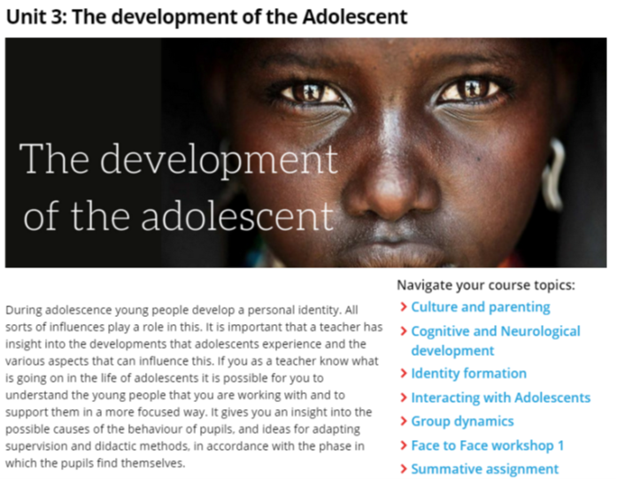

A full-fledged blended course catering to this specific target group

Slide 11






Local Partners

Slide 12
Mission 2020
scaling up and out,
promoting the use of innovative technology,
fostering sustainability, and
making this a template for similar programs to be deployed in other refugee crisis situations

Slide 13
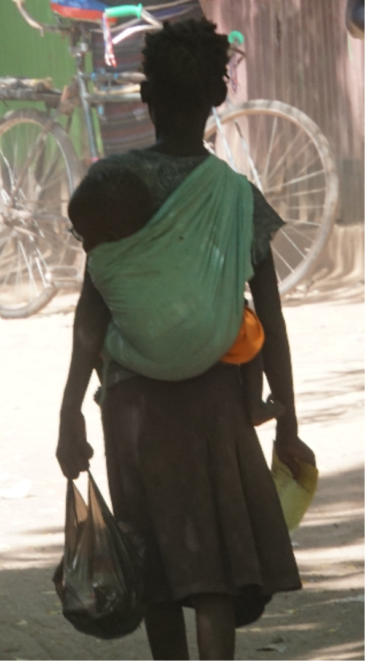
Our Biggest Challenges
Connectivity and Bandwidth
Achieving Locally Recognized
Accreditation
Locally Relevant Educational Input
Promoting Girls’ Education
Recognizing Trauma and Violence
Co-Creation and Co-Development
➔ Funding

Slide 14

Co-Creation and Co-Development:
Please share, ask questions, get involved

Slide 15
Help needed . . .
How can we improve connectivity?
How can we speed up the process of getting locally relevant educational input and locally recognized certification?
What can we do to get the girls to come to, and stay in, school?
Who will help us in developing this further?
How do we get adequate funding to meet our challenges?

