Slide 1
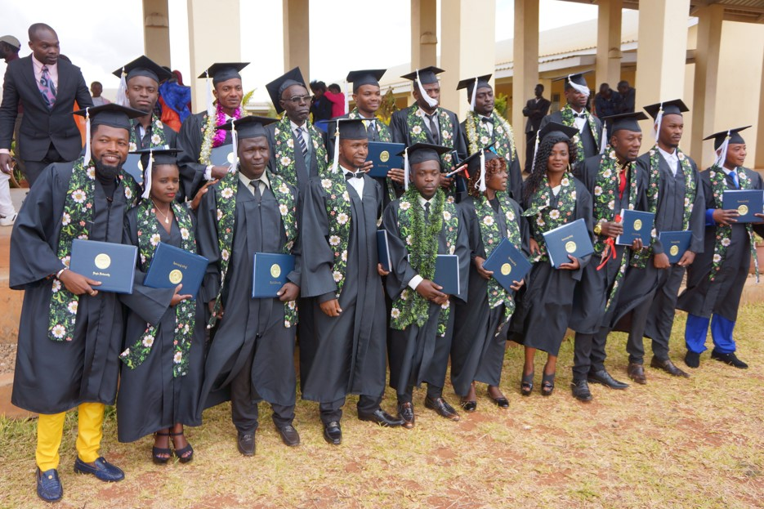
Higher Education at the Margins – A global perspective
Peter Balleis SJ, ICEFIL, Utrecht 31st August 2017
© Jesuit Worldwide Learning 2016 All Rights Reserved

Slide 2
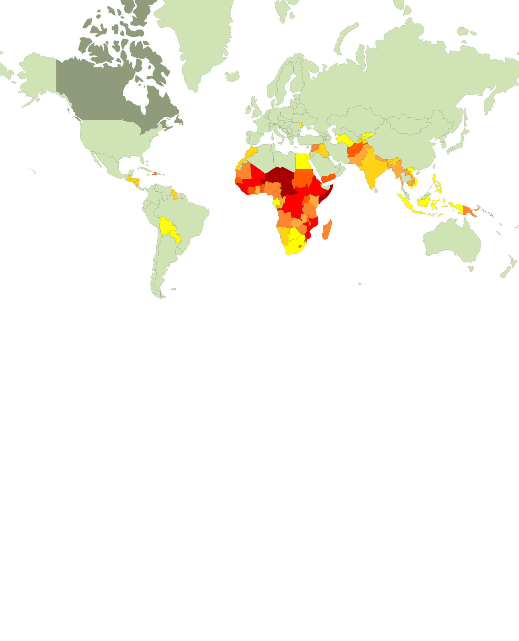
The Margins in our World
Human Development Index 2016
low per capita income
low live expectancy
low education
Digital divide
Poverty and marginalization
Religious fundamentalism and identity
Ecological degradation
Conflicts and forcible displacement
© Jesuit Worldwide Learning 2016 All Rights Reserved

Slide 3
The 2030 Agenda for Sustainable Development
Goal 4. Ensure inclusive and equitable quality education and promote lifelong learning opportunities for all
Goal 5. Achieve gender equality and empower all women and girls
Goal 10. Reduce inequality within and among countries
Goal 15. Protect, restore and promote sustainable use of terrestrial ecosystems, sustainably manage forests, combat desertification, and halt and reverse land degradation and halt biodiversity loss
Goal 16. Promote peaceful and inclusive societies for sustainable development, provide access to justice for all and build effective, accountable and inclusive institutions at all levels
© Jesuit Worldwide Learning 2016 All Rights Reserved

Slide 4
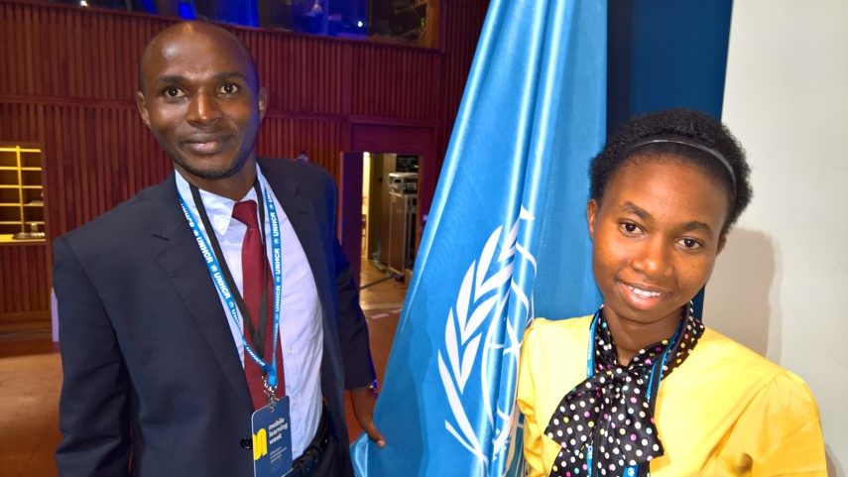
Our vision
Learning Together to Transform the World
Our mission
JWL provides equitable high quality tertiary learning to people and communities at the margins of societies - be it through poverty, location, lack of opportunity, conflict or forced displacement – so all can contribute their knowledge and voices to the global community of learners and together foster hope to create a more peaceful and humane world.
© Jesuit Worldwide Learning 2016 All Rights Reserved

Slide 5
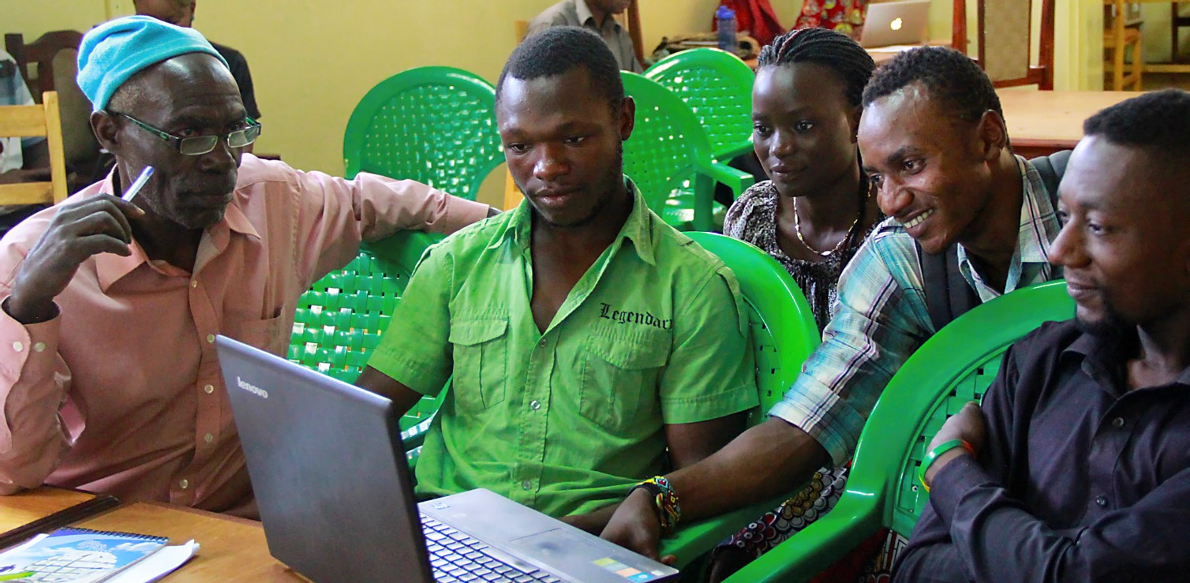
A blended model of online-learning
Onsite Tutor
Online Teacher
Students - learning community
© Jesuit Worldwide Learning 2016 All Rights Reserved

Slide 6
Building communities of learners & leaders
Global Community
Global virtual Classrooms
Local Learning Centers
Local Learning Groups
© Jesuit Worldwide Learning 2016 All Rights Reserved

Slide 7
An Alliance of collaboration
Students
Academic Institutions
Technology partners
Onsite partners
Funding agencies
© Jesuit Worldwide Learning 2016 All Rights Reserved

Slide 8
Transformative curricula
Language
Certificate
Global English
Professional
Certificates
Academic Credits / Degrees
Liberal Arts
Sustainable Environment
Responsible Global Leadership
Professional certified courses
Community Service Learning Tracks
© Jesuit Worldwide Learning 2016 All Rights Reserved

Slide 9
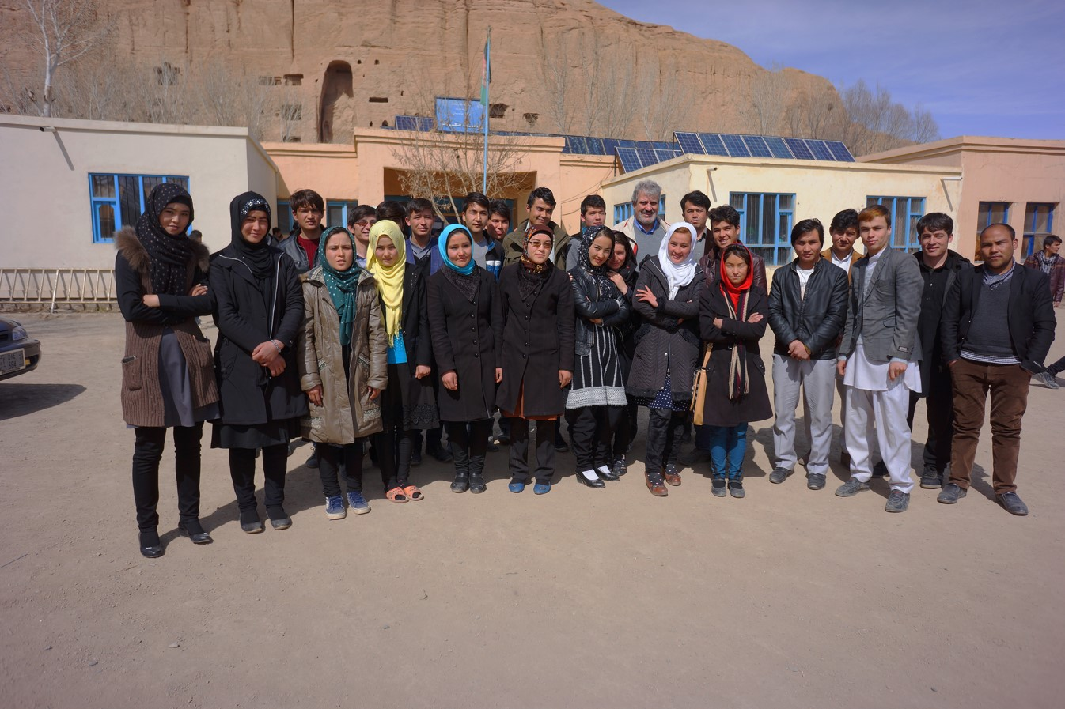
Our students
Over 20 countries
Over 3000 in 2017
Over 400 Diploma Students 2017
Over 40 different nationalities
Over 50% women
© Jesuit Worldwide Learning 2016 All Rights Reserved

Slide 10
www.jwl.org
Thank you very much
Global Advisory Board Meeting, Fribourg May 2017
© Jesuit Worldwide Learning 2016 All Rights Reserved

